Slide 1
Securing the Future of Payments
Yeo Siew Nee Risk Services, Southeast Asia
Bangkok, 11 September 2017

Slide 2
Disclaimer
Case studies, statistics, research and recommendations are provided "AS IS" and intended for informational purposes only and should not be relied upon for operational, marketing, legal, technical, tax, financial or other advice. You should consult with your legal counsel to determine what laws and regulations may apply to your circumstances. The actual costs, savings and benefits of any recommendations or programs may vary based upon your specific business needs and program requirements. By their nature, recommendations are not guarantees of future performance or results and are subject to risks, uncertainties and assumptions that are difficult to predict or quantify. Visa is not responsible for your use of the information contained herein (including errors, omissions, inaccuracy or non-timeliness of any kind) or any assumptions or conclusions you might draw from its use. Visa makes no warranty, express or implied, and explicitly disclaims the warranties of merchantability and fitness for a particular purpose, any warranty of non-infringement of any third party's intellectual property rights. To the extent permitted by applicable law, Visa shall not be liable to a client or any third party for any damages under any theory of law, including, without limitation, any special, consequential, incidental or punitive damages, nor any damages for loss of business profits, business interruption, loss of business information, or other monetary loss, even if advised of the possibility of such damages.
ALL BRAND NAMES AND LOGOS ARE THE PROPERTY OF THEIR RESPECTIVE OWNERS, ARE USED FOR IDENTIFICATION PURPOSES ONLY, AND DO NOT IMPLY PRODUCT ENDORSEMENT OR AFFILIATION WITH VISA

Slide 3
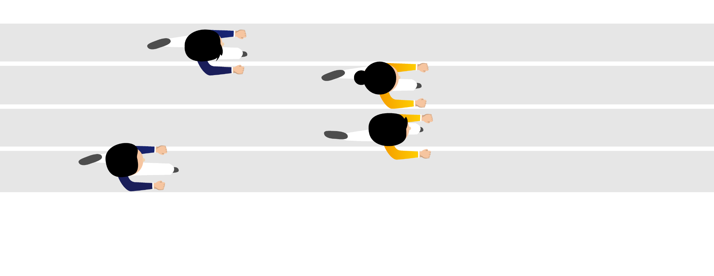
Responsible innovation
Security has to keep moving at the speed of innovation
Responsible
Innovation

Slide 4
Visa’s approach
Devalue data
Protect data
Advancing authentication

Slide 5
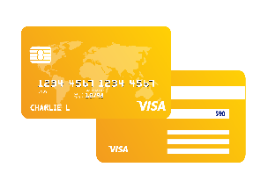
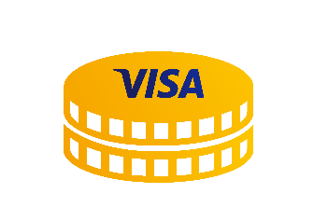
Devalue data
We have a number of measures to remove risk:
Moving to 100% EMV cards in Thailand
Investigating where sensitive data is stored
Tokenisation

Slide 6
Protect data
Fraudsters combine personal and payment data to create a complete profile
Safeguarding data isn’t only about payment fraud
Our focus is moving from static to dynamic data

Slide 7
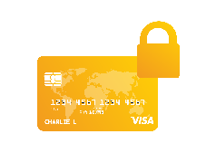
Advancing Authentication
Tools to eliminate fraud before it occurs
Risk-based 3D Secure
Mobile location confirmation
Card transaction control
Biometrics
Visa Public

Slide 8
Our future depends on building layers of security to protect and harness data
Devalue Data
Render data useless for criminals, reducing incentive for payment breaches
Empower Consumers
Engage cardholders as an underutilized resource in fighting fraud
Data
Transaction Alerts, Spend Controls
EMV, Tokenization
Protect Data
Safeguard payment data
Harness Data
Identify fraud before it occurs and increase confidence in approving good transactions
Encryption, PCI
3D Secure, Biometrics, Breach Response

Slide 9
Thank you

